Slide 1
Futuristic Technology Trends with Focus on AI and ML
Sujit gujar
Sujit.gujar@iiit.ac.in

Slide 2
Agenda
Into Future
What is Artificial Intelligence?
Future of AI
AI for Social Good
Current status of AI
AI @ IIITH
Role of ML in Modern AI Applications
Internet Advertising
Crowdsourcing

Slide 3
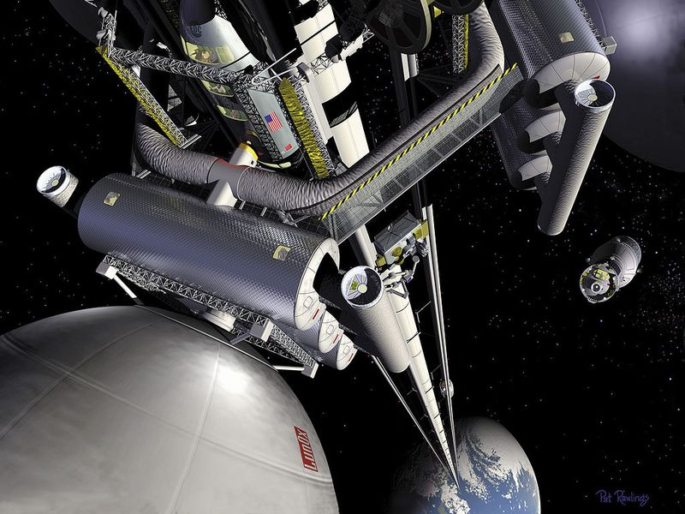
Space Elevator
By 2050 Obayashi Corporation Japan
Image: NASA

Slide 4
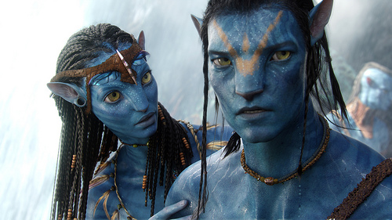
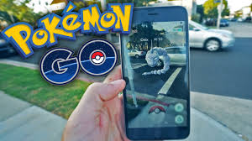
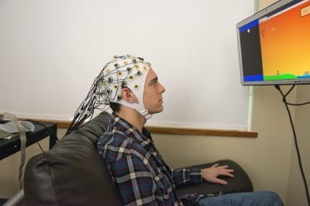
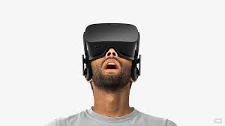
Avatar
Augmented Reality
Image: Wikipedia
Virtual Reality is already in place
Image: Quora
Image: Washinton.edu

Slide 5
Future of Technology
Technology
Cloud Computing
Enable
Analytics/IT for agriculture
AI
Data driven
Blockchains
High speed Internet (5G)
…..
Intelligent Healthcare
e-governance
Smart cities/home
ML plays a vital role
IoT

Slide 6
Artificial Intelligence (AI)
Artificial Intelligence (AI) is the science and engineering of making machines (including computers, robots and others) intelligent and enabling them to take actions and decisions that humans typically do
“Artificial intelligence is one of the most profound undertakings in science, and one that will affect every aspect of human life.”
- Stanford President John Hennessy

Slide 7
Where Does AI Stand Today?
AI has made a significant progress in the last three decades in the areas of computer vision, natural language processing, speech recognition
Currently popular areas of Machine Learning (ML) and Data Analytics
AI is touching the lives of billions of people through new era applications such as Cortana, Siri, Google Now which can run even on smart phones
…we are far from making machines that match human capabilities

Slide 8
Future of AI
Pieter Abbeel (UCB) : robots will keep us safer, especially from disasters
Stuart Russell (UCB): very smart computers could solve all our problems, including climate change
Matthew Taylor (WSU) : friendly robots could give the elderly live better lives
Murray Shanahan (Imperial College): AI will improve medical care

Slide 9
Future of AI
University of Oxford:
Machines will be better than us at translating languages by 2024 and writing school essays by 2026
Within ten years computers will be better at driving a truck than us and by 2031 they will be better at selling goods
AI will write a bestselling book by 2049 and conduct surgery by 2053

Slide 10
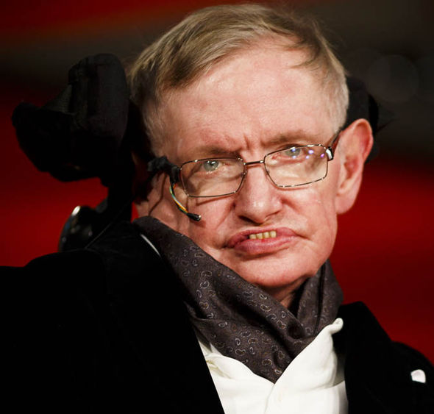
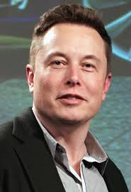
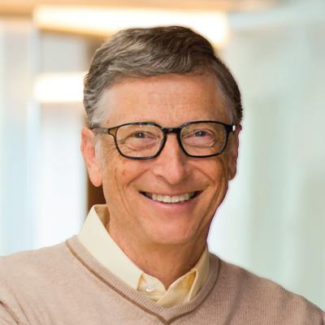
Future of AI and We (Humans)
Stephen Hawking: AI could end mankind
Elon Musk: AI will beat humans at ‘EVERYTHING’ by 2030
The robot that takes your job should pay taxes, says Bill Gates

Slide 11
It Need Not Be As Threatening As Above
Industrialization: Machines replaced lot of human jobs
Computers replaced lot of book-keeping/Accountants
Ray Zinn on Forbes in May 2017
economics, like life, finds a way
jobs will change, the economy will expand
AI will help create jobs
technical applications require a range of workers, from field techs who repair sensors to data scientists who model from massive data sets

Slide 12
AI for Social Good

Slide 13
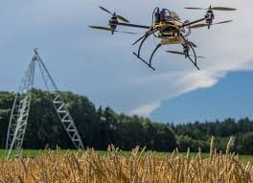
AI for Social Good (1)
The global population: 9B by 2050
means double agricultural production in order to meet food demands
Computer Vision
Data analytics for farmers
(weather patterns, soil type, water resource availability, nature of consumption patterns)
Efficient supply chain management

Slide 14
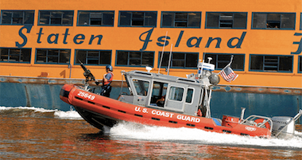
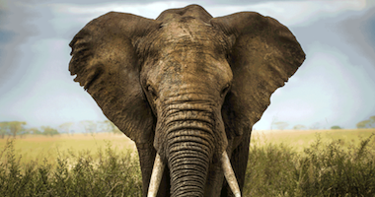
AI for Social Good (2)
AI for Public and Wild life Safety
Limited Resources
Use Game Theory, ML and AI
Automated Event Discovery
In Place in USA¹:
PROTECT
ARMOUR
PAWS
¹https://www.cais.usc.edu/
Images: Teamcore, USC

Slide 15
AI for Social Good (3)
In India: severe shortage of medical facilities and experts in the rural areas
By 2030, we will have a large aging population
Predictive diagnostics
use the large database of hospital records available to identify the susceptibility of each patient to different diseases and prepare them beforehand to handle the diseases to which they are susceptible
IoT based framework
assistive devices that can be used to monitor body vitals, provide safety alarm to doctors as needed and provide updates/feedback to the patients on timely basis

Slide 16
What is Possible Today?

Slide 17
Generating Images by Program
http://papers.nips.cc/paper/5423-generative-adversarial-nets.pdf

Slide 18
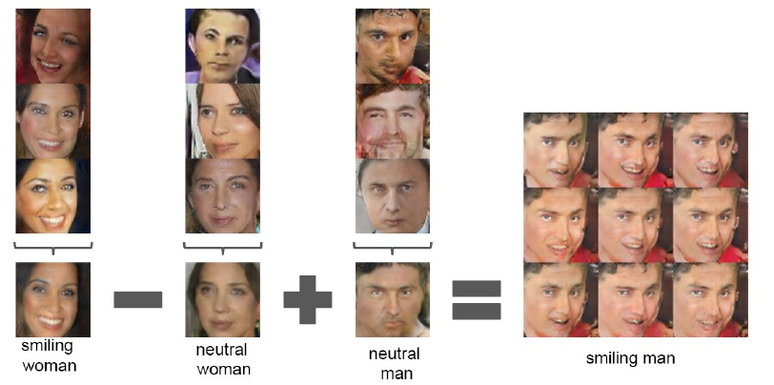
Image Arithmetic using Machine Learning
Image: https://arxiv.org/abs/1511.06434

Slide 19
Generating Speeches
Good afternoon. God bless you.
The United States will step up to the cost of a new challenges of the American people that will share the fact that we created the problem. They were attacked and so that they have to say that all the task of the final days of war that I will not be able to get this done. The promise of the men and women who were still going to take out the fact that the American people have fought to make sure that they have to be able to protect our part. It was a chance to stand together to completely look for the commitment to borrow from the American people. And the fact is the men and women in uniform and the millions of our country with the law system that we should be a strong stretcks of the forces that we can afford to increase our spirit of the American people and the leadership of our country who are on the Internet of American lives.
Thank you very much. God bless you, and God bless the United States of America.
https://medium.com/@samim/obama-rnn-machine-generated-political-speeches-c8abd18a2ea0

Slide 20
Machine Learning
What is Machine Learning?
learning from data
rather than relying to provide explicit instructions, machine learning algorithms use training sets of real-world data to infer models that are more accurate and sophisticated than humans could devise on their own
Landmark Techniques
SVMs, Decision Tress, kNN, Perceptron, Neural Networks and Deep Learning

Slide 21
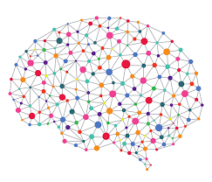

Deep Learning
Replicate neurons in human brains (Neural Network)

Slide 22
More of Deep Learning
Computer Vision
http://cvit.iiit.ac.in/cvsummerschool2017/index.html
Machine Learning
http://cvit.iiit.ac.in/mlsummerschool2017/

Slide 23
AI @ IIITH
Kohli Center for Intelligent Systems
25 faculty
State of the art research happens in
Analytics and IT for Agriculture
Computer Vision
Cognitive Science
Data Science
Information Retrieval
Machine Learning, Machine Translation
Natural Language Processing
Robotics

Slide 24
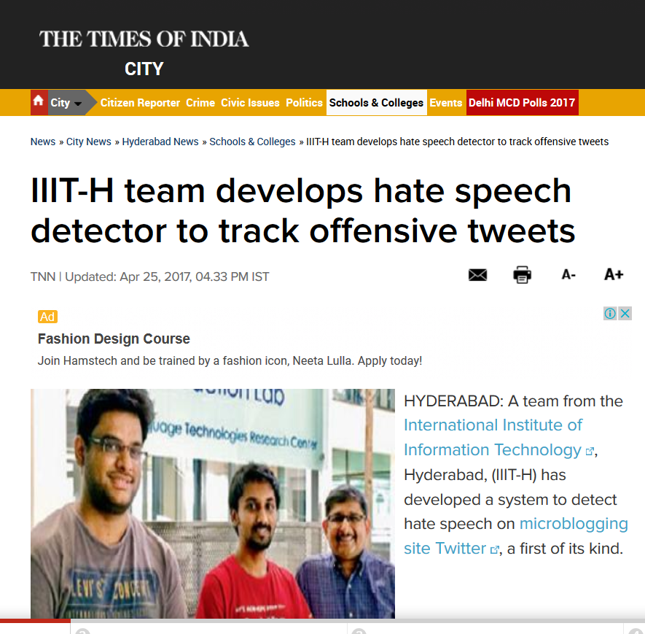
AI @ IIITH
Driverless Cars for Indian Roads
E-Sagu (IT for Agriculture)
Medical Image Diagnostics
Indian Language Translations

Slide 25
Role of ML in Modern AI Applications

